Slide 1

Wildfire smoke, evacuation exposure, and healthcare use in older adults who use electricity-dependent medical equipment
Heather McBrien, Sebastian T. Rowland, Tarik Benmarhnia, Sara Y. Tartof, Benjamin Steiger, Joan A. Casey
Notes:
Hi everyone, I’m Heather, and I’m a PhD student at Columbia in the Environmental Health program. I’ll be presenting our results from this paper: wildfire smoke, evacuation exposure, and healthcare use in older adults who use electricity-dependent medical equipment. I did this work with my supervisor Joan Casey who will also give a talk shortly, and these co-authors. This study is part of a larger research program where we’re trying to characterize the effects of climate-related exposures in potentially vulnerable populations so that we can inform climate resilience policy, and make our disaster response plans inclusive of everyone.

Slide 2
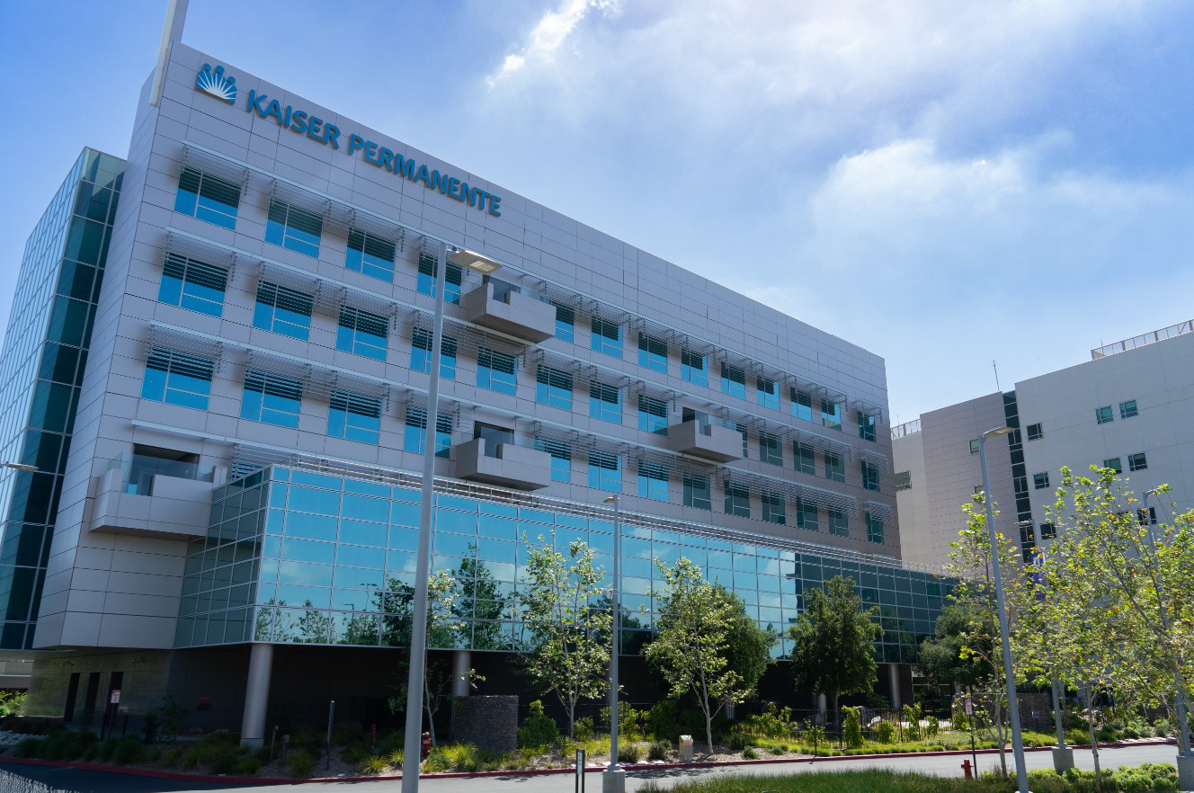
Notes:
In this study, used data from Kaiser Permanente Southern California, which is an integrated health care delivery system that serves 12 million members. We looked at the association between two different exposures to wildfire and frequency of health care use in older adults who use electricity-dependent medical equipment.

Slide 3
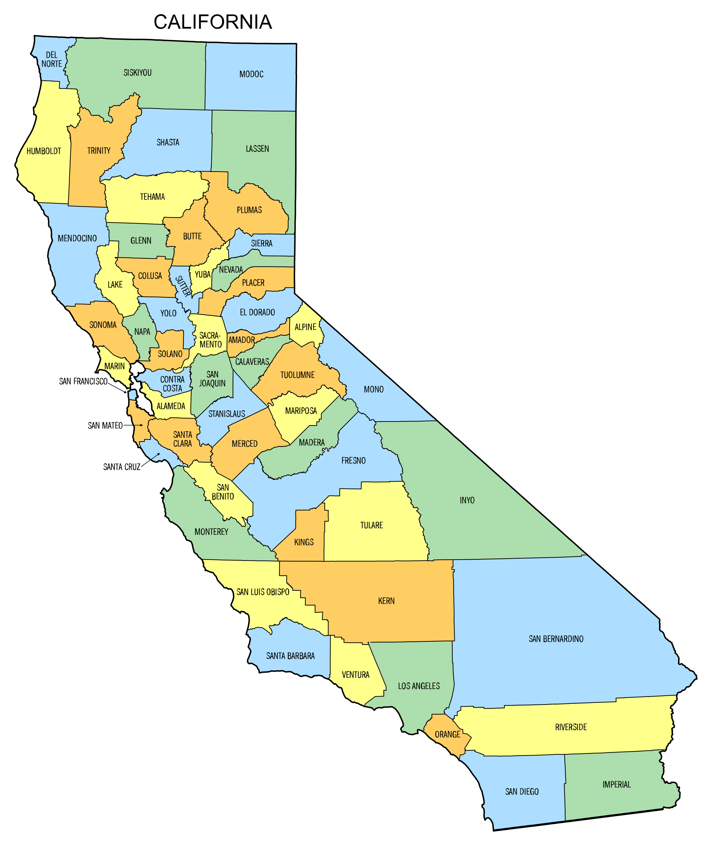
Notes:
To locate us further, here is a map of California with our study area at the bottom – it included seven SoCal counties. Wildfires in this area that were once like, unexpected, isolated disasters are now recurring chronic exposures happening multiple times a year.

Slide 4
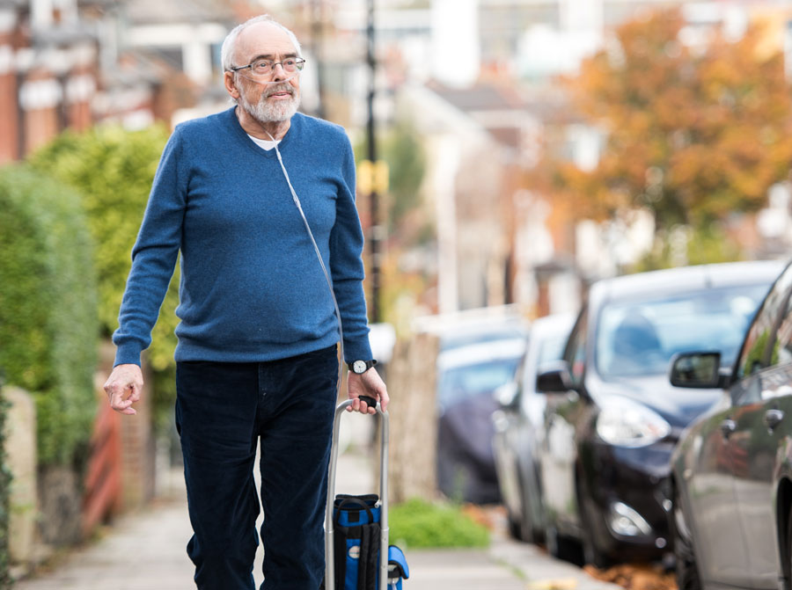
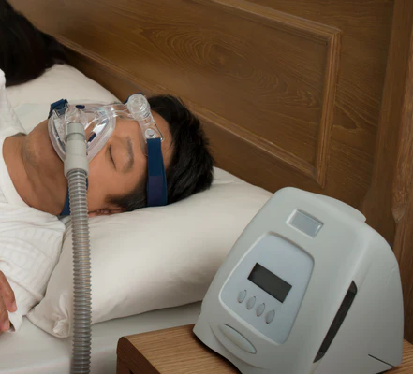
Notes:
We chose this population because we think people who rent electricity dependent medical equipment might be particularly vulnerable to cardiovascular and respiratory health effects from wildfire smoke, or to stress from wildfire evacuation. This equipment is things like oxygen concentrators, BiPAP machines, and at-home ventilators. If you use this equipment you’re usually using it to manage cardiovascular or respiratory illness, so it indicates some level of disability. These people might also be less able to evacuate because they need electricity to power what are often life-sustaining devices.

Slide 5
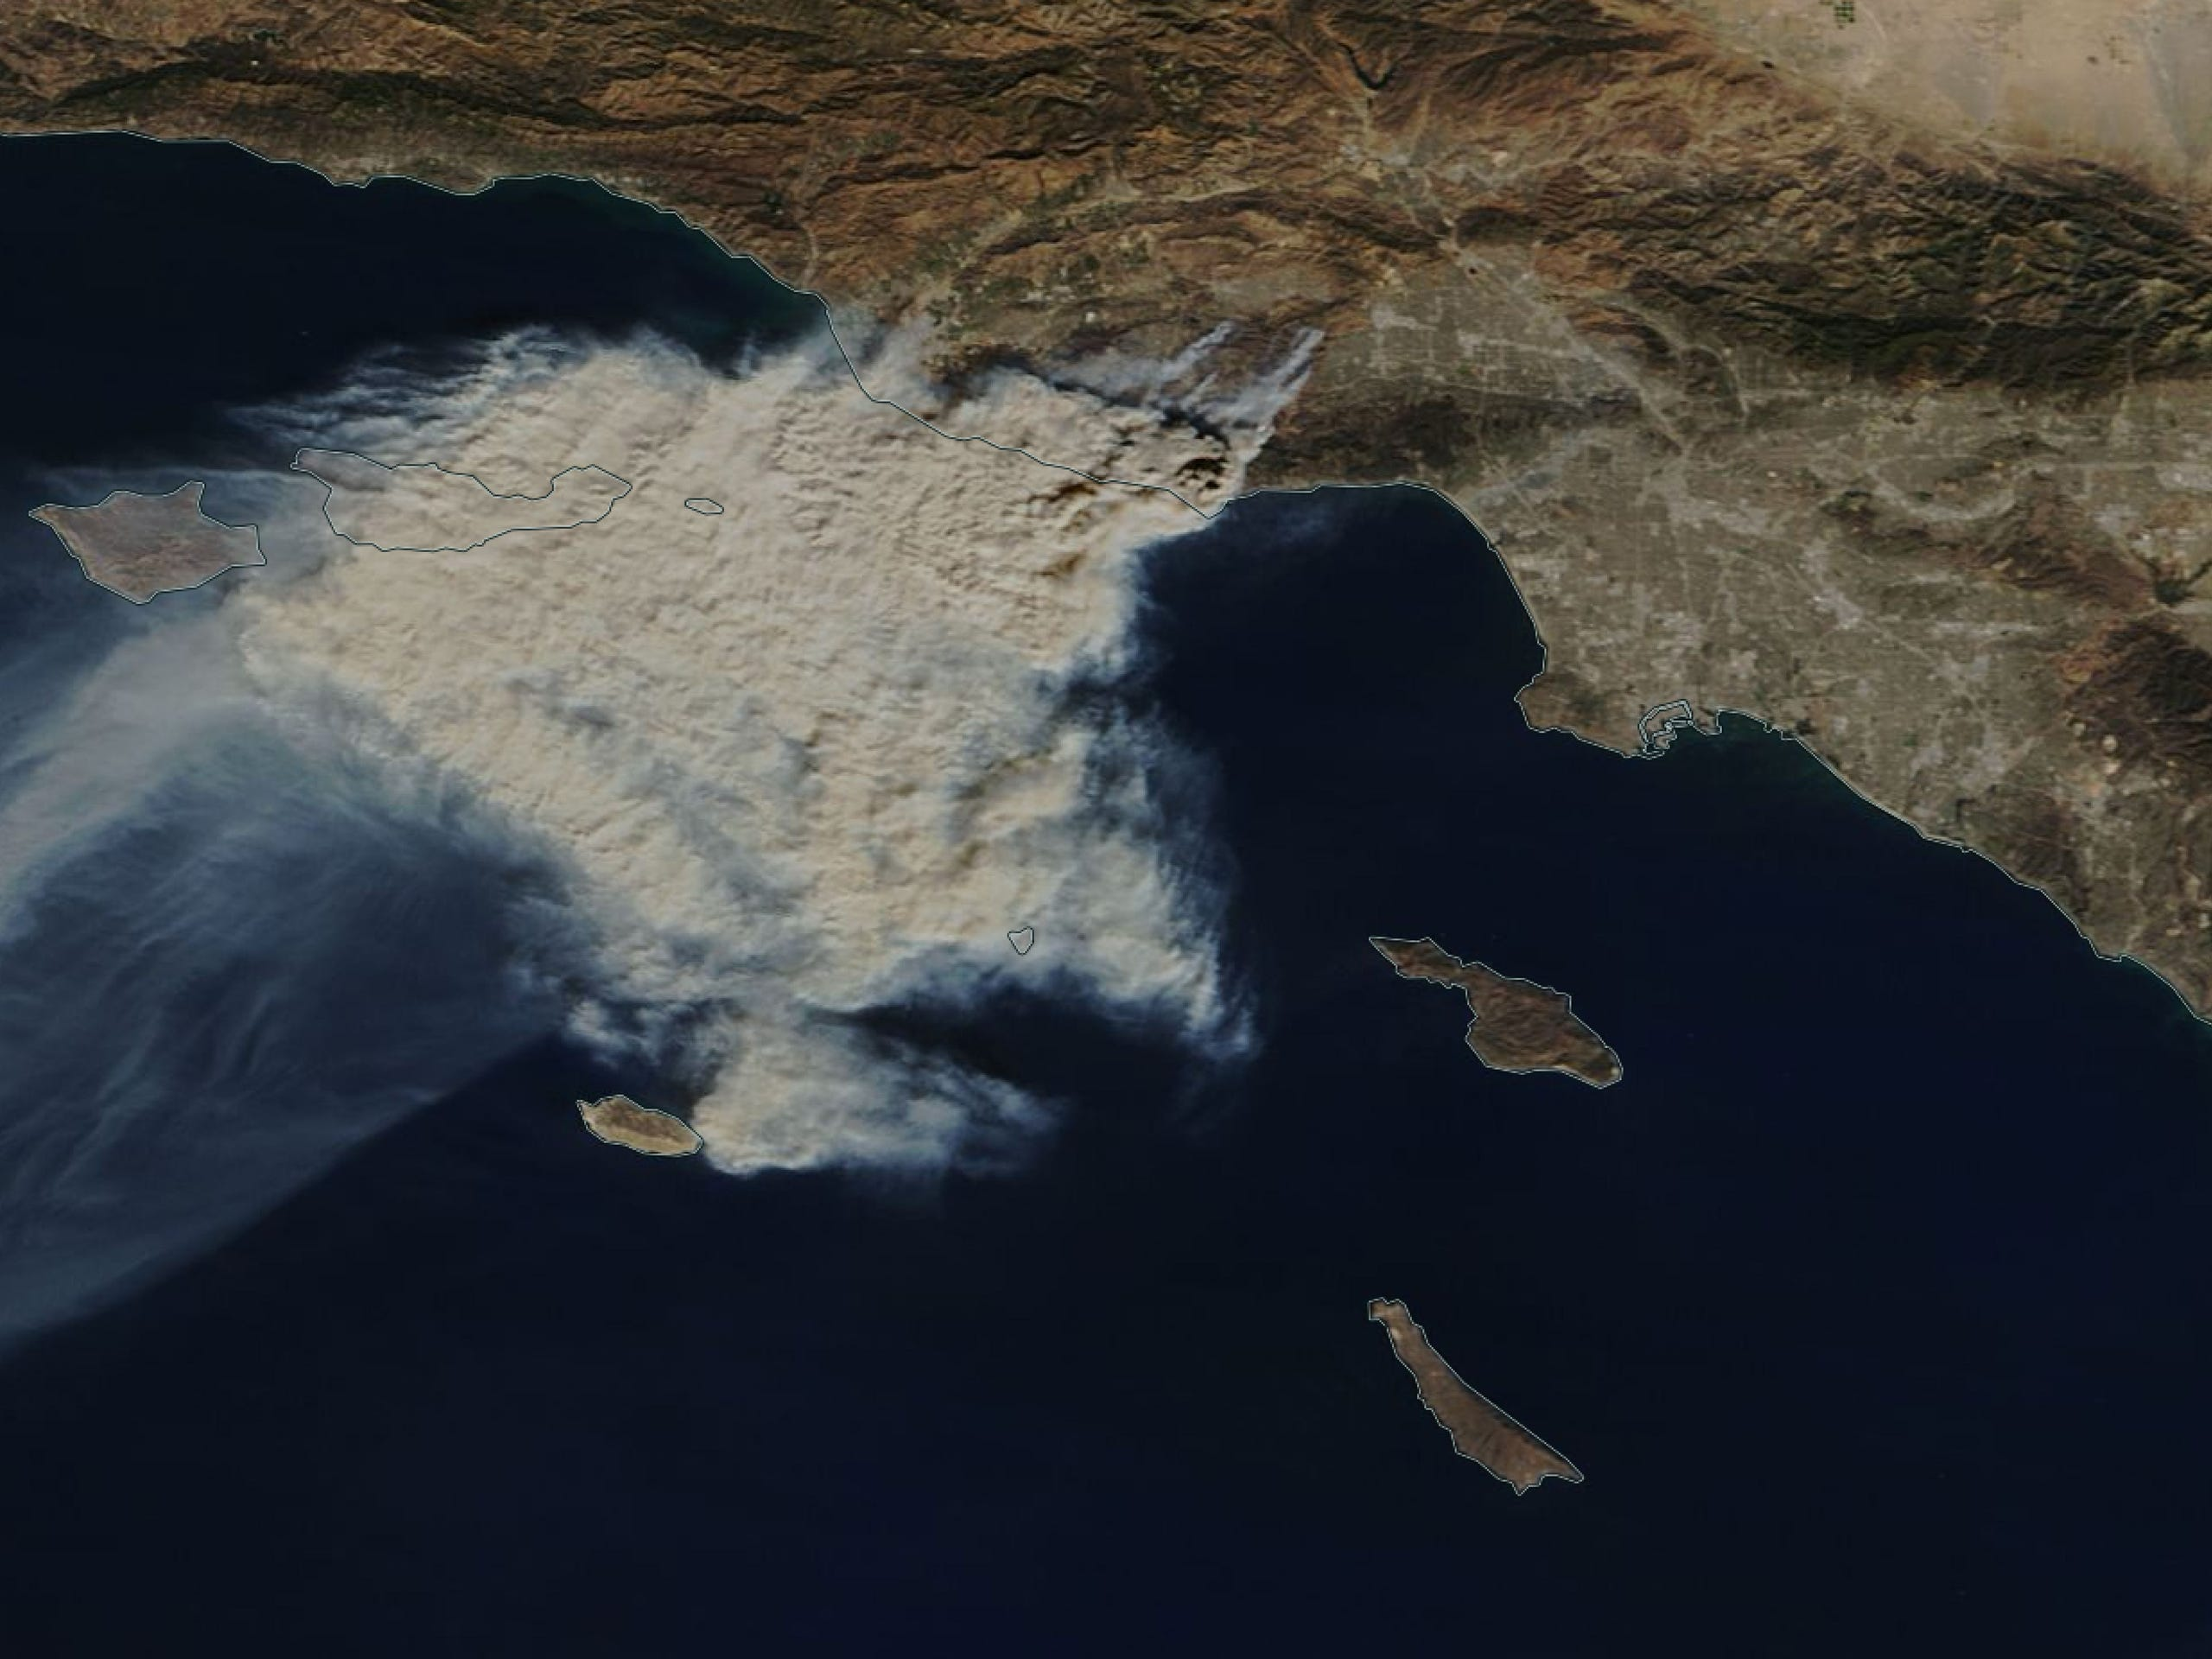
Notes:
To look at the association between wildfire exposure and healthcare use, we measured wildfire exposure in two ways. First, like other studies have done, we looked at wildfire generated PM2.5 concentrations, which have previously been linked to cardiorespiratory disease exacerbation. We used satellite-image based models to estimate daily wildfire PM2.5 concentrations by postal code, and linked them to each participant’s residential postal code. This is a satellite photo of smoke from the Woolsey Fire, which would have contributed significantly to the wildfire PM exposure in our study.
But, we also wanted to describe and quantify direct exposure to wildfire – like, if a fire is burning near your house and you are threatened with evacuation or your house burning down. While there’s a lot of literature looking at wildfire PM2.5, we feel this other exposure pathway that probably operates primarily through stress is really important and has gone mostly unmeasured.

Slide 6
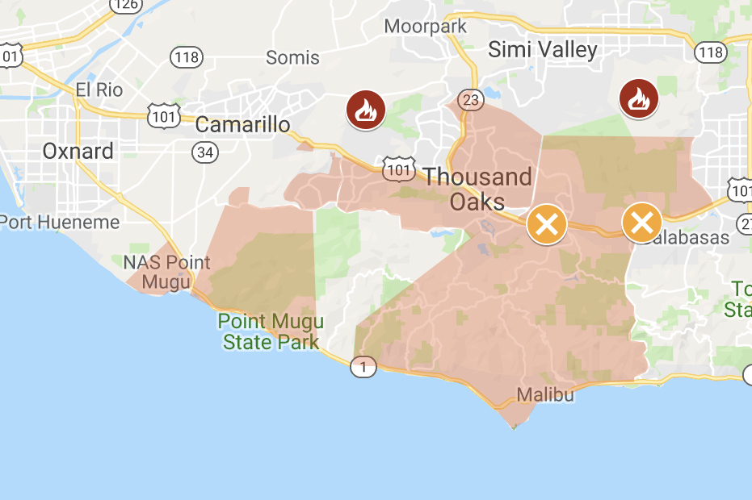
Notes:
To look at this, we got wildfire evacuation boundary data from news sites and the Los Angeles Fire Department archive for the 2018 Woolsey Fire, which was an enormous wildfire disaster. We digitized the maps of the evacuation zones that are shown here, and identified participants whose residential postal codes were in this evacuation zone plus a buffer, and considered them directly exposed to wildfire.

Slide 7
Outcome measurements:
Frequency of daily all-cause outpatient visits
Frequency of daily all-cause inpatient visits
Frequency of all-cause emergency visits
Frequency of inpatient visits for cardiorespiratory concerns
Frequency of emergency visits for cardiorespiratory concerns
Notes:
We modeled the relationship between each of these two exposures and daily postal-code level counts of 5 types of healthcare visits with adjusted negative binomial regression models. We look at outpatient visits for all causes, inpatient visits for all causes, and emergency visits for all causes, and then inpatient visits for cardiorespiratory disease, and emergency visits for cardiorespiratory diseases. We singled out cardiorespiratory related visits because again literature suggested that there would be PM2.5 effects related to these outcomes, and we think our population here might be at an elevated risk of these cardiorespiratory disease exacerbations to begin with.

Slide 8
Emergency
cardiorespiratory
Inpatient
cardiorespiratory
All-cause emergency
All-cause inpatient
All-cause outpatient
RR
Notes:
I’ll share a some of our results here - these are results comparing healthcare use in people whose residential postal codes were evacuated during the Woolsey Fire to those who weren’t. We found associations between evacuation exposure and decreased outpatient visits, and increased inpatient admissions for cardiorespiratory disease. We also found associations between exposure to wildfire-generated PM2.5 and increased outpatient visits. Again, a lot of studies have looked at healthcare use and wildfire PM 2.5, but very few have looked at outpatient visits related to wildfire, so these findings are new in that way.

Slide 9
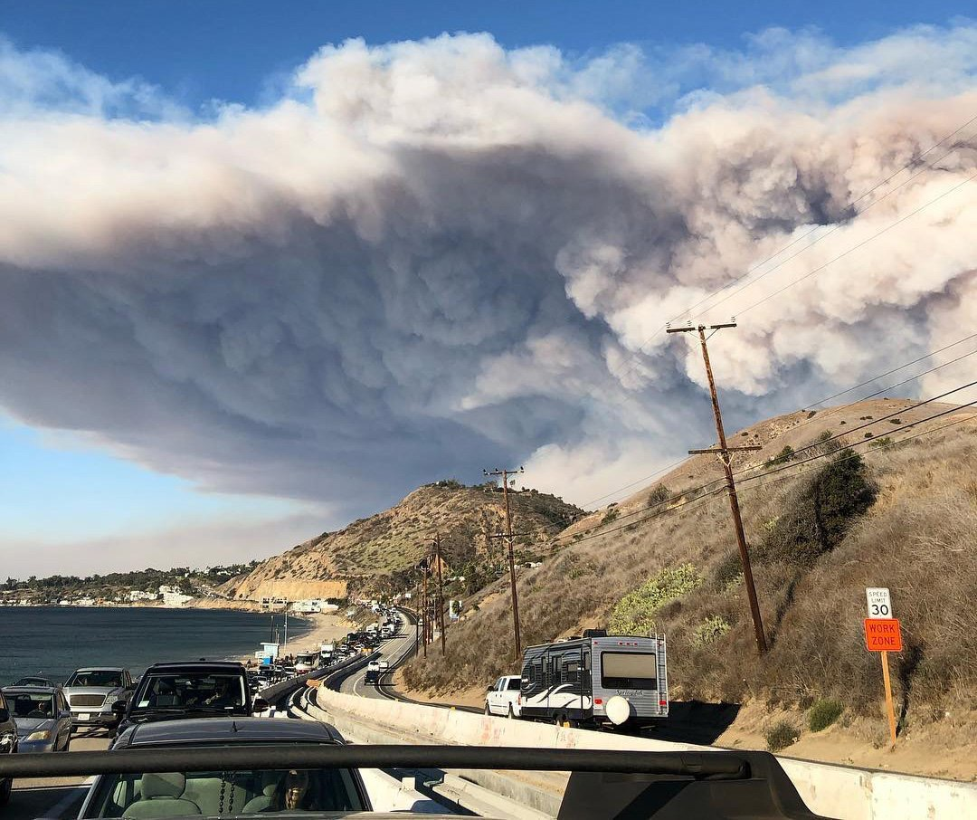
Notes:
This is a picture of the Woolsey Fire smoke plume and the evacuation, just to remind us how powerful these fires are, and what our exposure actually is. These results suggest that wildfire evacuation might interrupt routine outpatient care, just as we would expect, and at the same time older adults who use electricity-dependent medical equipment may be experiencing health effects of wildfire smoke exposure. So, as wildfires become a more chronic exposure, with climate change, we need to pay attention to people who might be experiencing the effects of wildfire first or more intensely than the rest of the population, and keep access to care and safe evacuation in mind.

Slide 10
Thank you to the team!
+ NIA
(RF1AG071024)
Thank you to coauthors Sebastian T. Rowland, Tarik Benmarhnia, Sara Y. Tartof, Benjamin Steiger, and Joan A. Casey
Questions can be sent to my email at:
hm2913@cumc.columbia.edu
Jen Manly
Notes:
Thank you.

